Slide 1
Project Write-ups
Escaping Reality
Title should be appealing, preferably non-tech
Clarity
No overly technical jargon that is hard to understand
Context
Ensure project sounds relatable to the layperson
Images
Check that they are meaningful, not just codes, screens etc

Slide 2
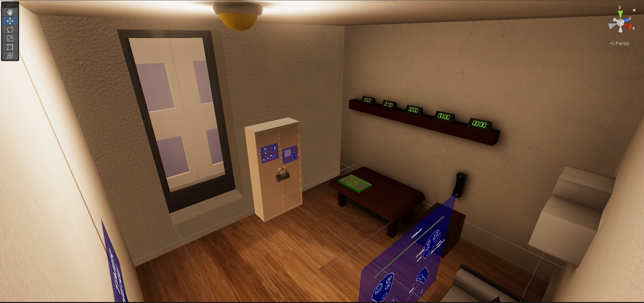
Escaping Reality
A VR escape room experience developed in Unity.
Project Team Members
Stanley Lu
Ong Jian Qin
Ryan Oh
Supervisor
Mr. Sean Lim

Slide 3


Escape Room Simulator
Project Background
As part of Temasek Polytechnic’s growing efforts to stay updated with current media trends, the diploma in Game Design & Development (GDD) has been renamed to Immersive Media & Game Development (IMGD) to better reflect the paradigm shift in terms of the entertainment industry from a static, on-screen experience to a virtual/augmented reality one.
This project was made with the intention of enticing potential new students and demonstrating exactly what virtual reality development within IMGD can achieve and to show what is possible when a potential IMGD graduate-to-be goes through the IMGD course.
Escaping Reality, the project in question, captures the essence of what is possible when a student decides to enroll in the Diploma in Game Design & Development and in the future, IMGD. The game sees the player be transported into a virtual apartment where they have accidentally locked themselves in the room and must now solve puzzles in order to escape.
With a proposed 5-minute gameplay time, Escaping Reality brings about a quick and engaging activity to promote and showcase the lessons taught and possibilities in GDD/IMGD.
Project Team Members
Stanley Lu
Ong Jian Qin
Ryan Oh
Supervisor
Mr. Sean Lim

Slide 4

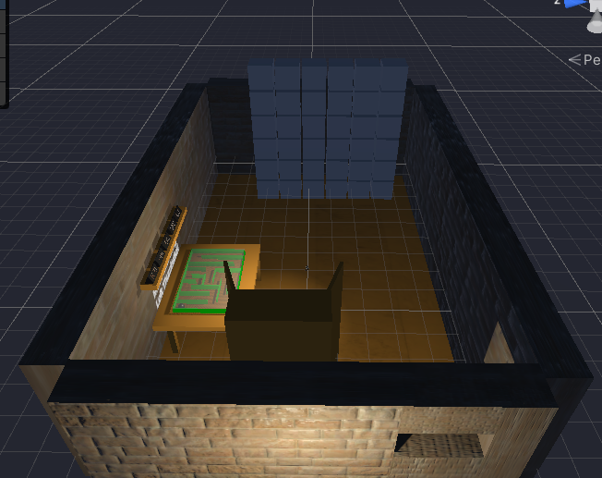
Escape Room Concept
Project Team Members
Stanley Lu
Ong Jian Qin
Ryan Oh
Supervisor
Mr. Sean Lim

Slide 5
Game Scene
Project Team Members
Stanley Lu
Ong Jian Qin
Ryan Oh
Supervisor
Mr. Sean Lim

Slide 6
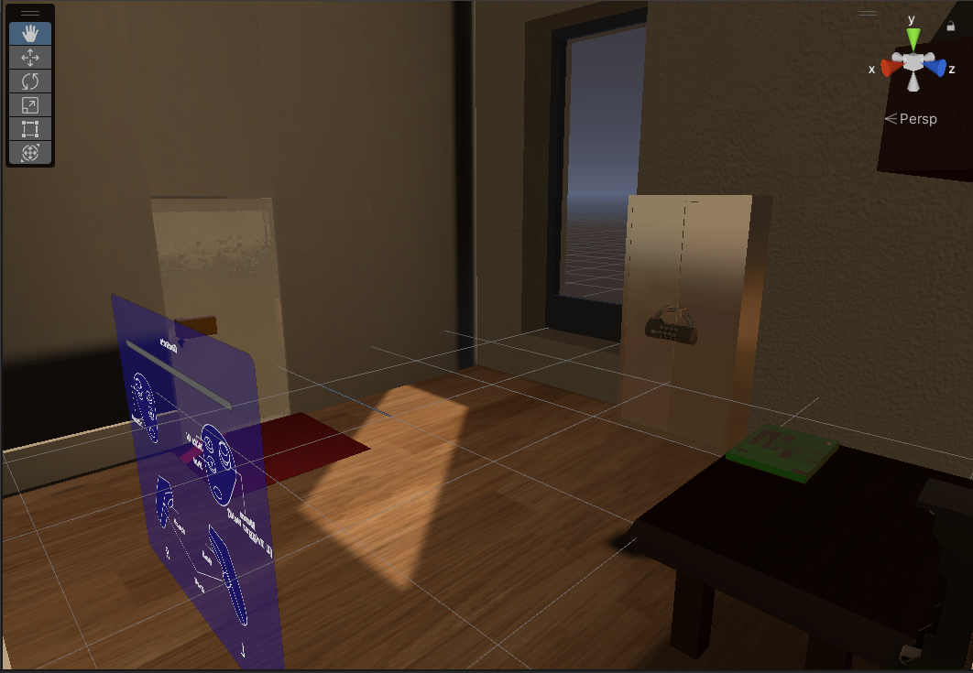
VR Escape Room
Project Background​
Project Team Members
Stanley Lu
Ong Jian Qin
Ryan Oh
Supervisor
Mr. Sean Lim

Slide 7
Escaping Reality
Key Benefits
Adjective – Interactive and fun
Immersive – Astonishing gameplay that explores new technology to intrigue users into trying it out.
Key Technologies Used
Unity
Oculus SDK
Potential Enhancements
This project can be enhanced with the following:
Adding more puzzles
Adding more decorative game objects (such as furniture)
Industry Partner
Temasek Polytechnic
Project Team Members
Stanley Lu
Ong Jian Qin
Ryan Oh
Supervisor
Mr. Sean Lim

